Slide 1
OPEN ELECTIVE OCS1903-PROGRAMMING USING PYTHON WEEK 6

Slide 2
CONTENTS
Python Lists
List Definition
List Creation
Accessing List
Mutability
List Operators
List Functions
MCQ
Problem Solving

Slide 3

List – []
List is a data structure(collection) in python which is used to store the sequence of element of various types.
List is a collection which is ordered and changeable. Allows duplicate members
[] is used to represent the list data structure.
List are mutable-means the elements in the list can be modified.
The items in the list are separated with the comma (,).Elements of the list can be accessed by their index.

Slide 4
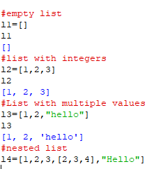
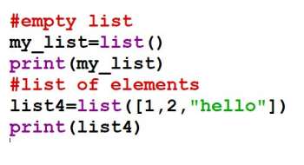
List creation
List is created by placing all the elements within square brackets , separated by commas or using list() command

Slide 5
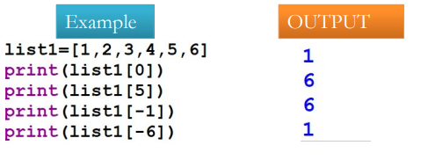
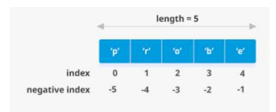
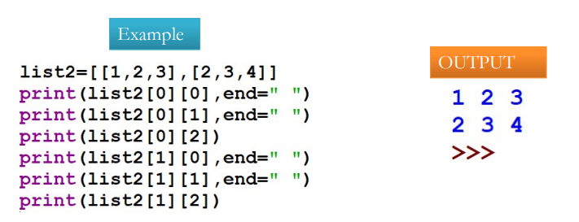
Accessing List – List Indexing
List elements are indexed starting from 0.
List supports negative indexing starting from the list element indexed as -1.
List elements can be accessed through their index.
Accessing Nested List

Slide 6

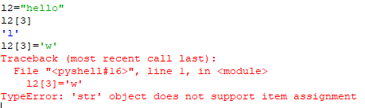
List Mutability
Unlike Strings List are mutable , so the ability for certain types of data to be changed without entirely recreating it. Elements can be modified.

Slide 7
List Operators
Slicing
Concatenation
Repetition
Membership
Identity

Slide 8
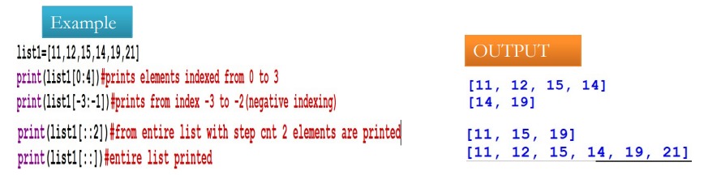
List Slicing
To access a range of elements from the list , we can go for list slicing.
Slicing operator[::] , that is list[start : end : step]
End always represents end-1. example list[1:3] will print 1 and 2 elements from list.

Slide 9
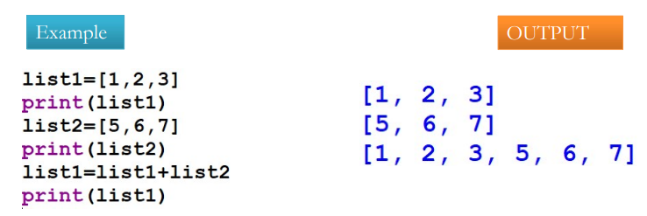
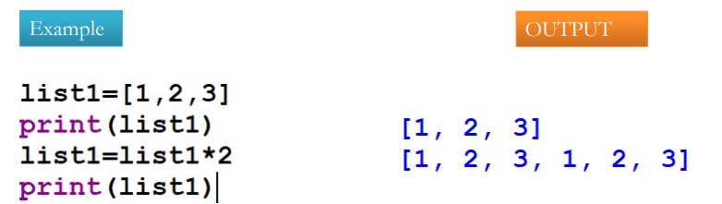
List concatenation and repetition
To concatenate two lists we can use + operator
* enables the list elements to be repeated multiple times

Slide 10
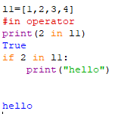
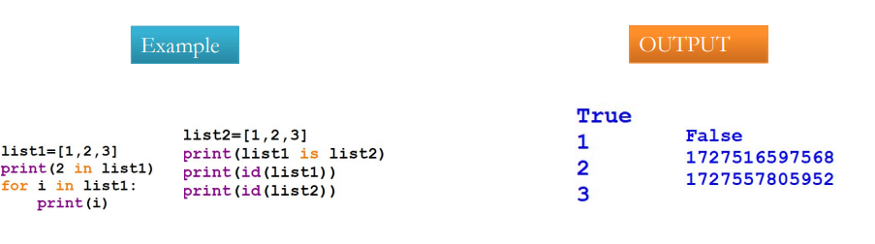
List –in and is operators
In operator returns only two possible values ​​True when the element is in the list, and False when it is not.
Is checks whether given object is List or not.

Slide 11
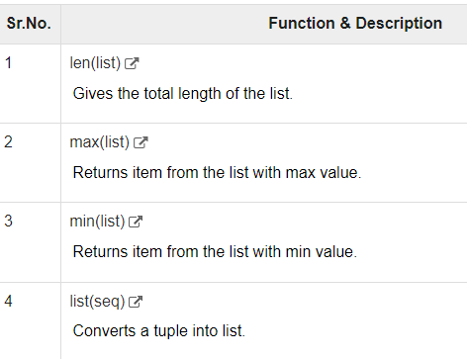
List Built in Functions

Slide 12
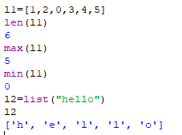
List Built in Functions Example

Slide 13
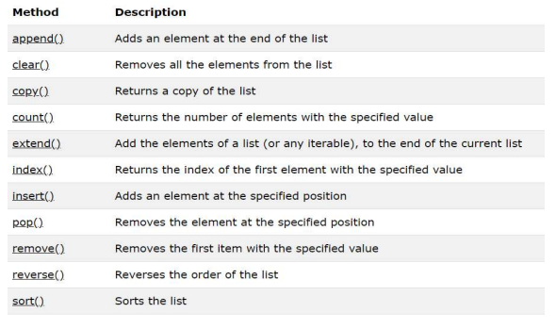
List Built in Methods

Slide 14
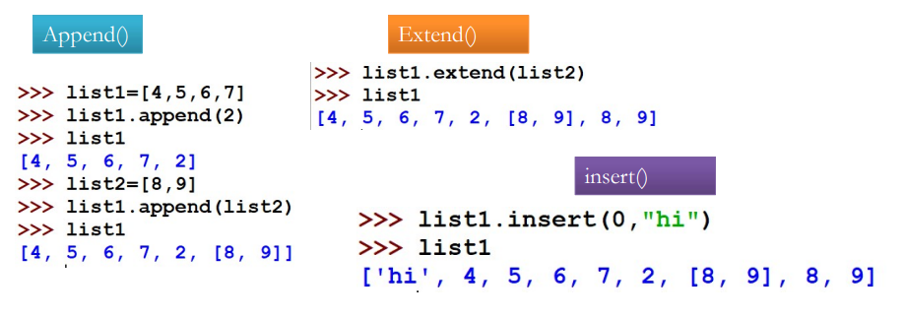
Append Extend and Insert Methods

Slide 15
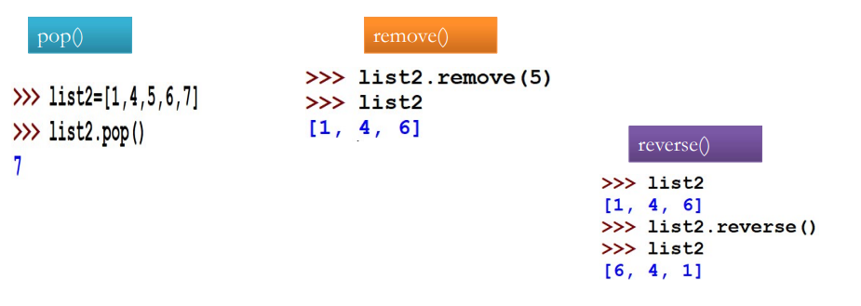
pop remove and reverse Methods

Slide 16
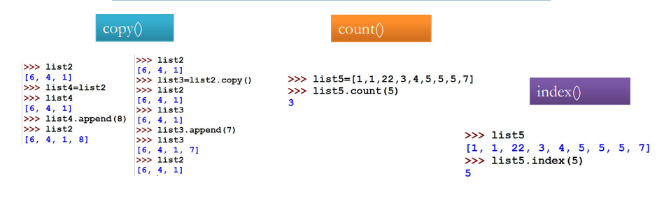
copy count and index Methods

Slide 17
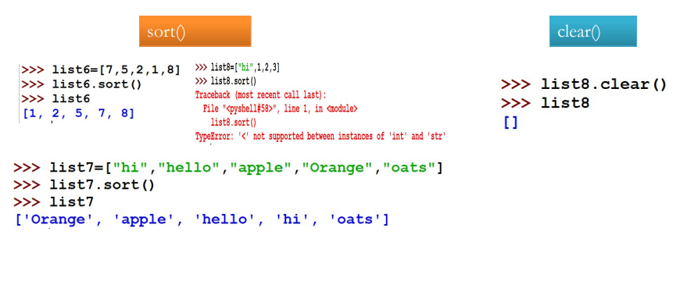
Clear and sort method

Slide 18
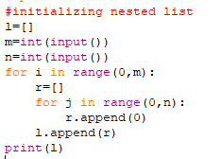


Nested List
Nested list can be initialized/values can be moved using two ways
Using Nested for loop
Using list comprehension
Output
Output

Slide 19
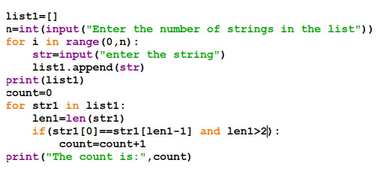
Python code 1
Write a Python program to count the number of strings where the string length is 2 or more and the first and last character are same from a given list of strings. Sample List : ['abc', 'xyz', 'aba', '1221'] Expected Result : 2.
Input:
List of strings
Eg: ['abc', 'xyz', 'aba', '1221']
Output:
Count of the strings
1.Length more than 2
2.First and last character Should be same
aba and 1221 count=2

Slide 20
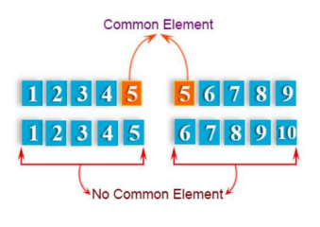
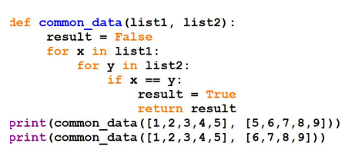
Python code 2
Write a Python function that takes two lists and returns True if they have at least one common member.

Slide 21
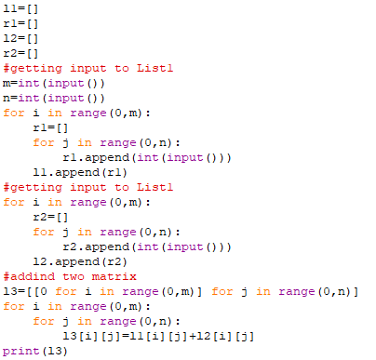
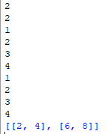
Python code 3
Write a Python program to add two matrix

Slide 22
MCQ
What is the output when we execute list(“hello”)? a) [‘h’, ‘e’, ‘l’, ‘l’, ‘o’] b) [‘hello’] c) [‘llo’] d) [‘olleh’]
What will be the output of below Python code?
list1=[8,0,9,5] print(list1[::-1])
A. [5,9,0,8] B. [8,0,9] C. [8,0,9,5] D. [0,9,5]
Output:
A
Output:
A

Slide 23


